Slide 1

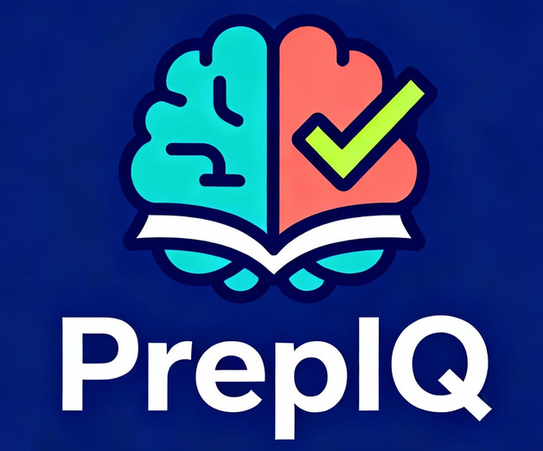

TEAM - ANYTHING
PrepIQ: The AI-Powered StudyMate
Team Members:
Eshita Badhe and Aarya Chaudhari

Slide 2

Problem Understanding
Study resources are scattered - Students move between notes, YouTube videos, MCQ apps, PDFs, and tutors because no single platform covers everything.
Content is not syllabus-aligned - Most tools provide generic material that doesn’t match the student’s board, university, or exam pattern.
No personalization - Students receive the same questions and lessons regardless of their strengths, weaknesses, or learning pace.
Weak performance insights - Existing apps rarely show detailed analytics or guide students on what to study next.
Inefficient practice - Practice questions are random, repetitive, or outdated; difficulty doesn’t adapt to performance.
Time-consuming paper creation - Students and teachers struggle to generate balanced, syllabus-based sample papers manually.
Lack of an all-in-one solution - platform integrates content, practice, analytics, revision, and guidance under one ecosystem.

Slide 3
Our Solution: PrepIQ - Your All-in-One Study Companion
Syllabus - Aligned
Content strictly based on your uploaded documents and syllabi, with Retrieval-Augmented Generation (RAG) to ensure context-aware, hallucination-free responses.
Proposed Solution
PrepIQ is an all-in-one AI-powered exam preparation platform designed to overcome the limitations of current tools. It seamlessly integrates syllabus-aligned content, intelligent learning, and engaging features to transform your study experience.
Intelligent Learning
Personalized study paths, AI-generated adaptive content, and diverse learning methods like quizzes, flashcards, and mind maps.

Slide 4












Windows 7 UI
Context Chatbot
Familiar & Clean Interface
Answers from Your Materials
Personalized Notes
Key Features
AI Study Planner
Detailed, Summaries, Mind Maps
Adaptive Schedule
Sample Papers
History Management
AI-Generated Practice Exams
Track Interactions
Learning Games
Streak Maintenance
Quizzes, Riddles, Flashcards
Motivation & Notifications

Slide 5


Technical Methodology: From Research to Development
Phase 1: Research & Analysis
Phase 2: Design Phase
We surveyed students to identify key pain points: 80% reported AI inaccuracy, 60% cited syllabus misalignment. We also analyzed existing tools to understand their limitations, confirming the need for a comprehensive solution.
We designed a user-friendly UI/UX with a nostalgic Windows 7 aesthetic, created information architecture for document and note organization, and wireframed core user flows.
Phase 3: Development Sprint
Developed a full-stack application leveraging React, Python/Flask, integrated RAG with ChromaDB, Supabase for auth/storage, and Groq LLM (llama-3.1-8b-instant) for intelligent AI responses.

Slide 6
PrepIQ vs. The Rest: A Clear Advantage
Feature | PrepIQ | ChatGPT | Notion AI | Quizlet | Competitive Advantage
Syllabus Alignment | ✓ Yes | ✗ No | Limited | Limited | Ensures highly relevant content.
Context-Aware | ✓ Yes | ✗ No | ✗ No | ✗ No | Eliminates inaccuracies and hallucinations.
Multiple Note Formats | ✓ 6+ Formats | Basic | Basic | Flashcards Only | Catches diverse learning preferences.
Adaptive Study Planning | ✓ AI-Driven | Manual | Manual | Manual | Personalized, flexible schedules.
Voice Interaction | ✓ Yes | Limited | ✗ No | ✗ No | Hands-free and intuitive learning.
Gamification Suite | ✓ Full Suite | ✗ No | ✗ No | Limited | Boosts engagement and motivation.
PrepIQ stands out by combining comprehensive features that existing solutions lack, offering syllabus alignment, true context-awareness, diverse learning formats, and a full gamification suite all in one platform.

Slide 7
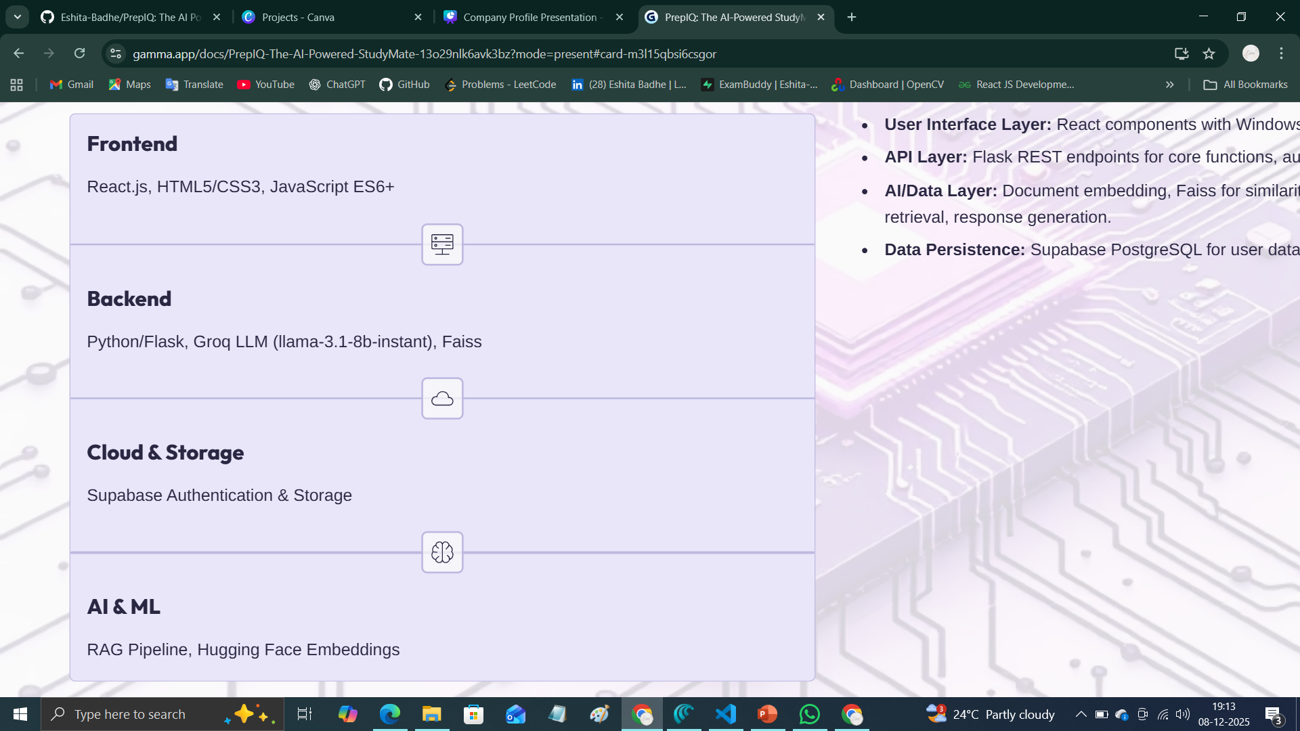
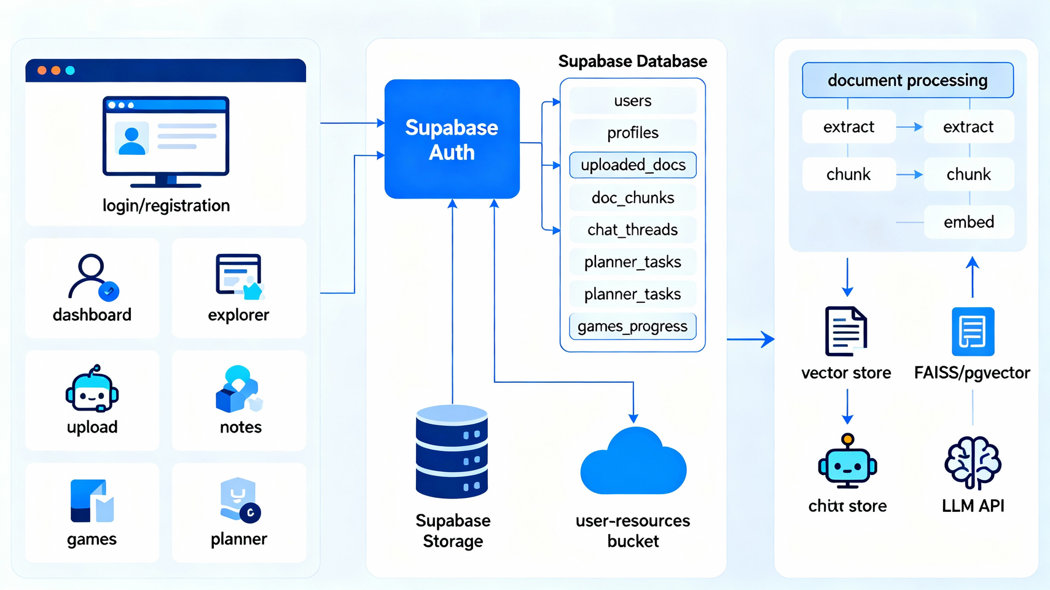
Tech Stack & Architecture

Slide 8
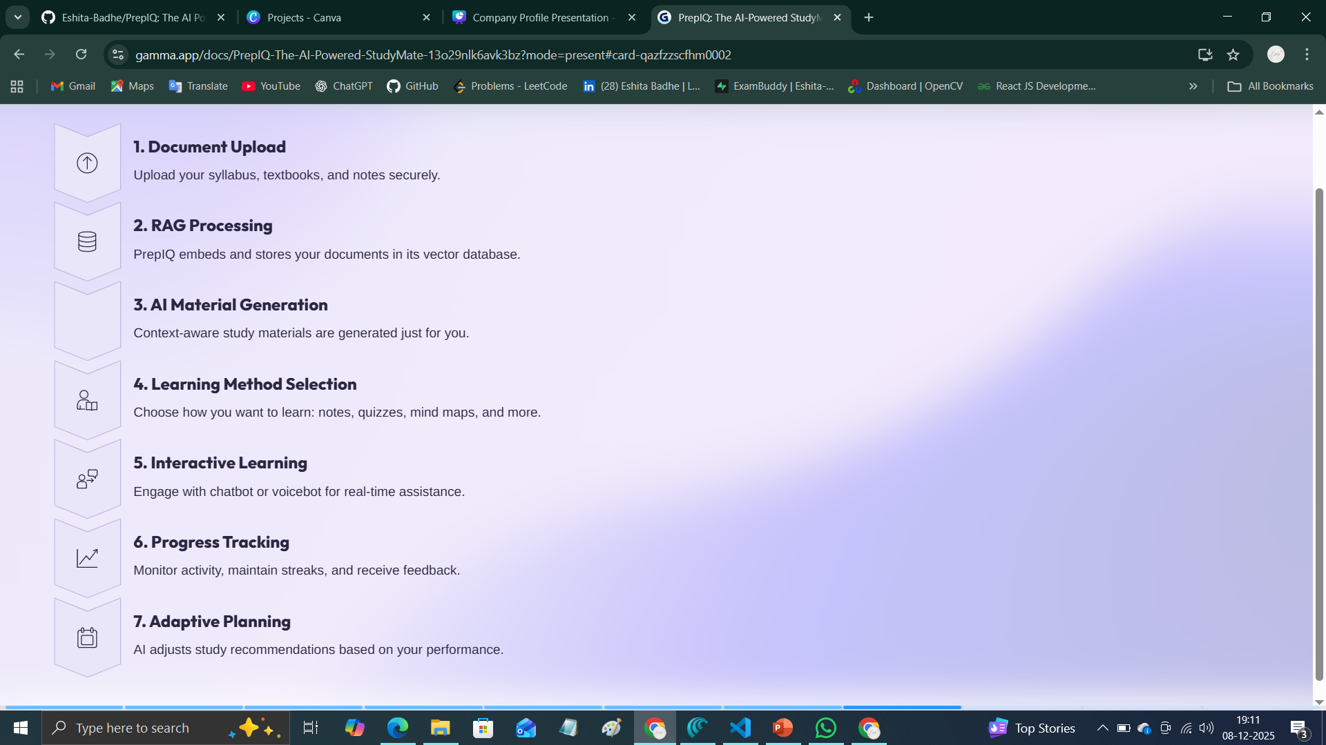

System Workflow

Slide 9



Expected Impact
Technical Subjects
Theory-Heavy Subjects
Student uploads Math notes, PrepIQ generates step-by-step explanations, practice problems, and flashcards. Outcome: 92% accuracy with deep conceptual understanding.
History notes are used to create mind maps, summaries, and gamified quizzes. Outcome: Retention improves from 60% to 85% with engaging methods.
Personalized Assistance
Voicebot explains complex concepts like photosynthesis, retrieving information from uploaded Biology materials. Outcome: Doubts clarified in real-time, boosting comprehension.
Conclusion
PrepIQ is more than an AI tool; it's a comprehensive ecosystem transforming exam preparation from frustrating to engaging, personalized, and highly effective. Ready to revolutionize your study habits?

Slide 10
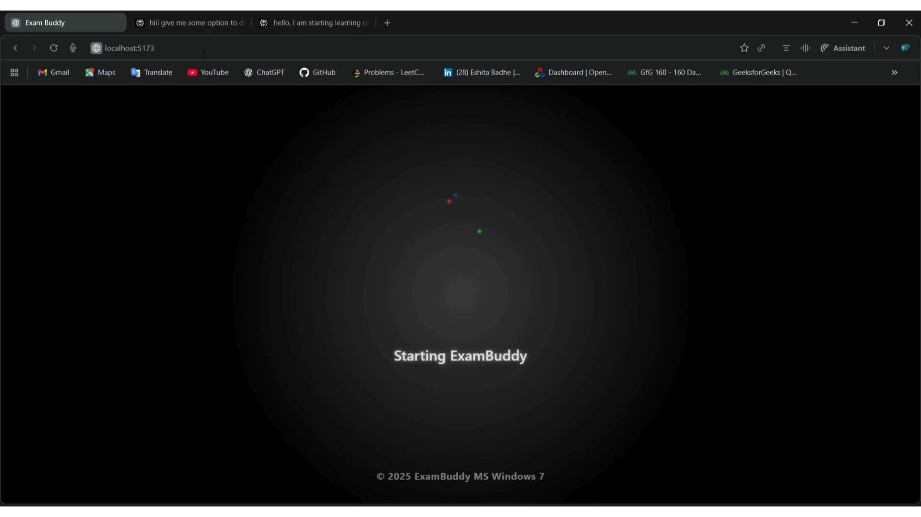
DEMO
GitHub Repository -
https://github.com/Eshita-Badhe/PrepIQ
Demo Video -
https://github.com/Eshita-Badhe/PrepIQ/blob/main/PrepIQ_Demo.mp4

